Slide 1
PyOne
For Rapid Automation

Slide 2
About PyOne
PyOne is a simple, portable, self-evolving - pyqt based python application developed for my personal and official use.
The main purpose of this tool is to do a rapid automation for any type of windows based development/testing and other activities, regardless of tools and technologies in existing place.
It self-evolves and supports to any situation, process, tools or systems for which users can build their own custom tools in amazing blazing speed.
All you need is very basic python knowledge.

Slide 3
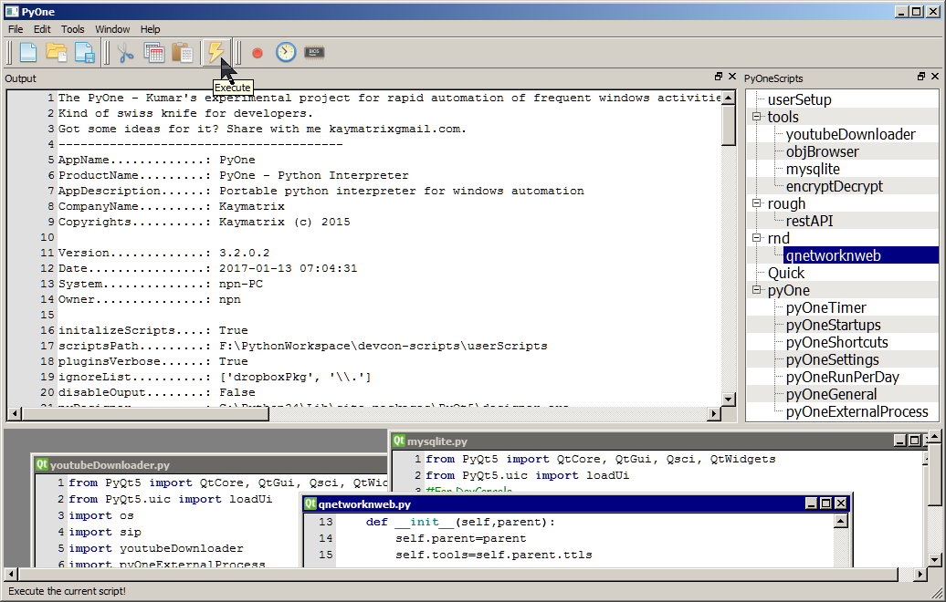

Slide 4
PyOne’s Interesting challenges
Daily check IND/AUD Currency rate and send me alert when threshold level reached. also log the rates to DB and give me a beautiful graph.
A Manual deployment has a series of steps like Editing XMLs, File updates, CSV updates, cross checking server names etc. Which should be automated with visually clean neat GUI so users can simply click items and buttons.
Call a specific RESTful service and fetch JSON details, Based on it cross check data in my Google Cloud and update the file present in my Dropbox Cloud.
Daily shakeout testing fetches details about various server health and serve the reports in a custom web service hosted with-in, so people can check reports from remote.
Firefighter Situation: 50k DB Records need to be manually checked against 10k xml file data. Based on result need to update various other xml files. All need to be done in 2 days.
And many more… Explore yourself.

Slide 5
More About PyOne

Slide 6
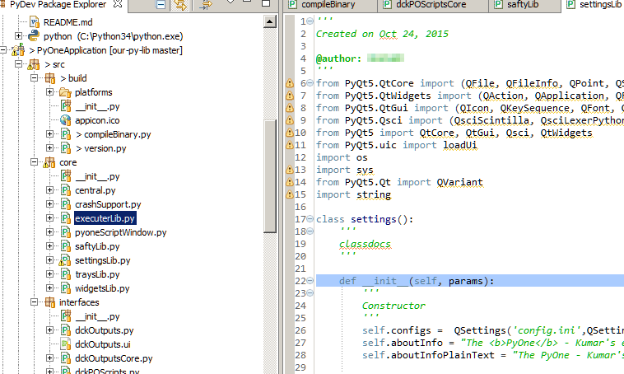
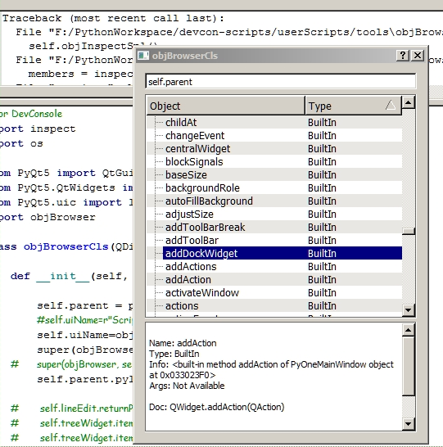
PyOne Build
Built is based upon x86 – 64bit Python 3.0 with PyQt5 and Other basic modules built in it.
Compiled to Standard Standalone 64bit Binary executable for windows execution. (No Installation needed)
PyOne has built-in Qt Based Python Interactive Interpreter with all most all PyQt5 modules.
PyOne uses PyQt GUI Designer (packed along with PyOne) for rapid GUI based tool building.
More modules like mat-lab, graph plotting, pysci, pil, pygames etc can be included (Through source build).
Entire application is openly available for rebuilding with-in itself. User has full freedom to transform the tool to their need.

Slide 7
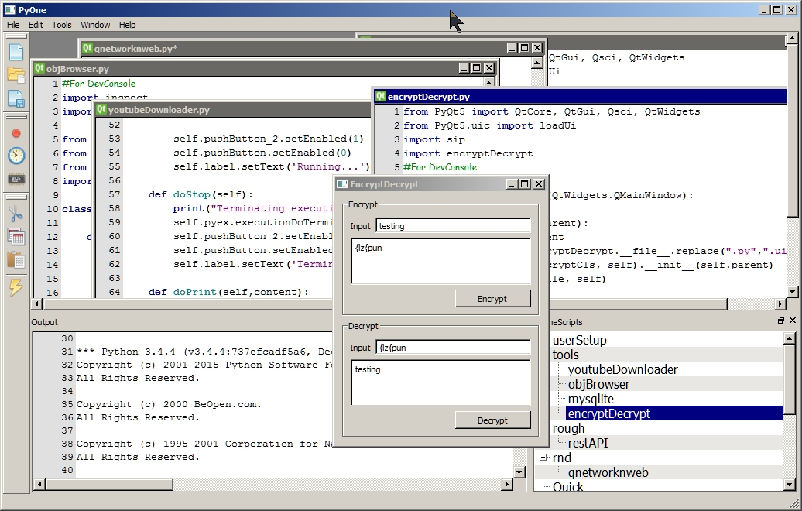
Flexible Framework

Slide 8
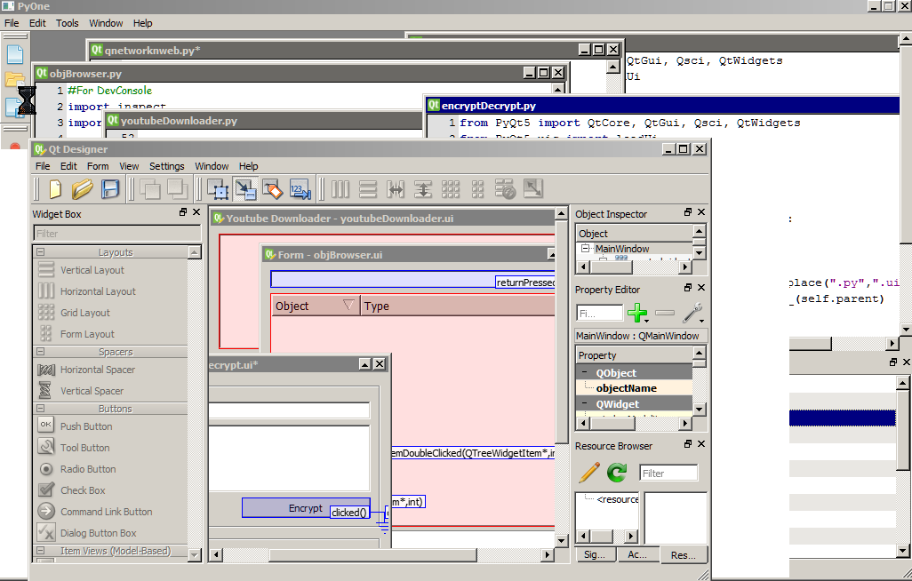
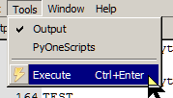


PyOne Framework
PyOne scripting framework has nothing specific. It’s almost similar to simple dynamic python execution.
Framework has been defined with various structures for building the new plugins to it, which simple python users can use it with no time of learning.
PyOne itself already evolved to a certain stage with help of its own Script Framework.
GUI or NON-GUI any application can be built with this framework. GUIs are PyQt based loads dynamically.
Built-in colourful icons (fatcows - farmfresh) for building your GUIs rapidly with colourful icons.
MDI Editor, Editor enabled with QsciScintilla & Python Lexer, Dockable windows, Standard Error and Outputs, Dynamic Execution, Error Handling, Threads etc

Slide 9
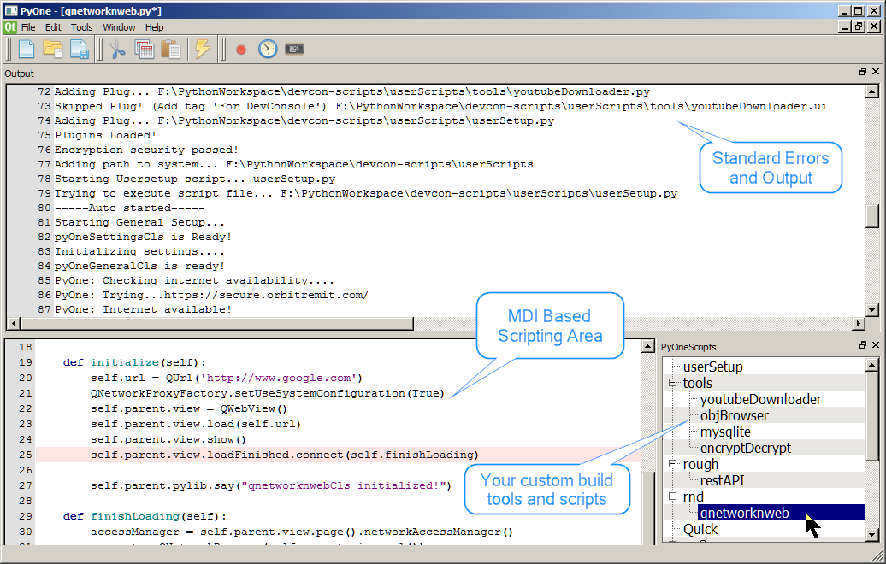

Slide 10
Some more… Challenges for PyOne.
Call a webservice in a specific interval and parse XML and convert to JSON and call RESTful.
Quickly deploy/host a web service, handling the various GET/POST request. Also act as an application server..
Download any youtube video based on viewer rating, comments, date, playlist, video formats etc.
Perform and maintain health check data in SQL database of a various servers.
Handle XML/XSD/XSL/HTML/JSON/CSV/TEXT/BATCH/BASH or any ASCII based file operations.
Handles HTTPS/HTTP/SSL/SOAP/REST/Webservices with basic python modules.
Various file-based operations like read/write/copy/delete/move/upload/download/sync files in specific interval or on-demand or based on result of various other activities.
Encrypt/Decrypt base64 with custom keyword based security.
Execute certain code daily once when the application starts.
Execute certain code in specific interval of time.
Execute custom DOS batch application on specific time and fetches the system-outs.
Execute EXEs as visually customized shortcut cuts.
And many more tools on the fly.

Slide 11
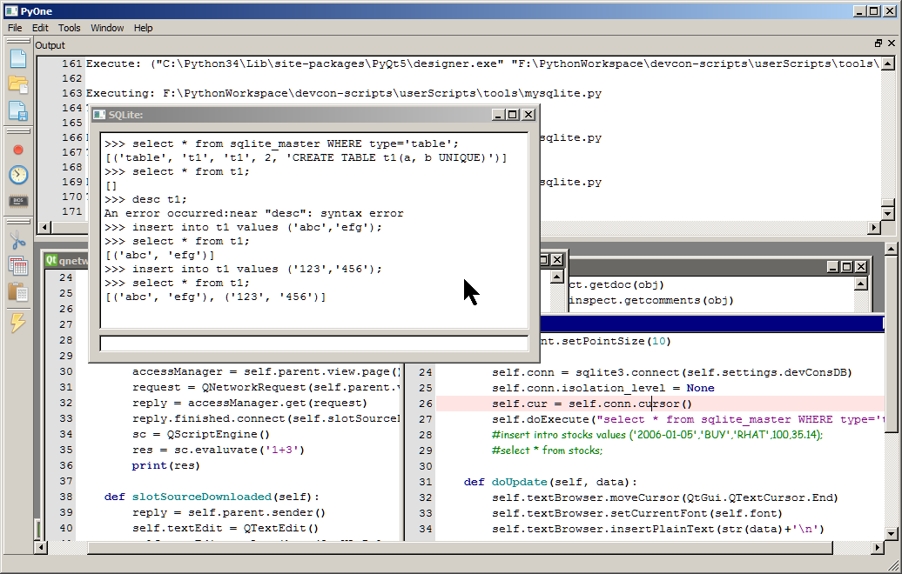

Slide 12
How to do?
A Simple tool in 10 mins

Slide 13
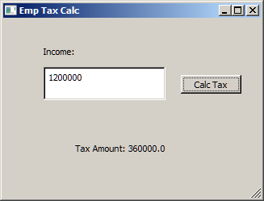
Let’s quickly build a simple tool - Employee Tax Calc
Points to Consider 1. Should get user input Income amount from in a Text box. 2. Based on latest TAX Formula, calculate the TAX amount for the Income specified. 3. Display the TAX amount in another text area. 4. Calculation should happen on Click of a button. 5. And you got 10 mins time to do the tool.

Slide 14
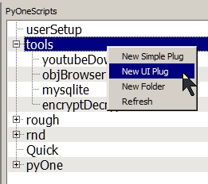
Step 1
Right click any section under ‘PyOneScripts’
And Select ‘New UI Plug’ Option

Slide 15
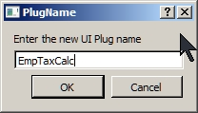
Step 2
Provide a name (EmpTaxCalc) for your new tool.
And
Click ‘OK’

Slide 16
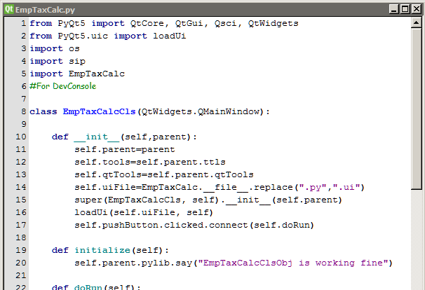
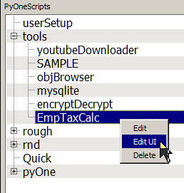
Step 3
TaDa!!! You are given with basic script and UI
for editing and enhancing as per your requirement. Now right click EmpTaxCalc in PyOneScripts and Click EditUI

Slide 17
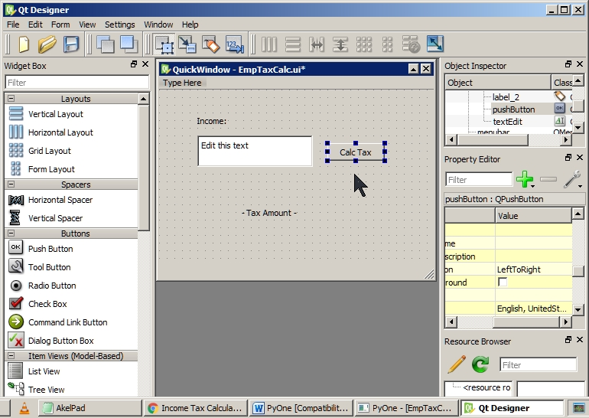
Step 4
QtDesigner will be launched automatically with UI Script file.
Drag n Drop and Do your own GUI with the help of QtDesigner and save the file once you completed.

Slide 18
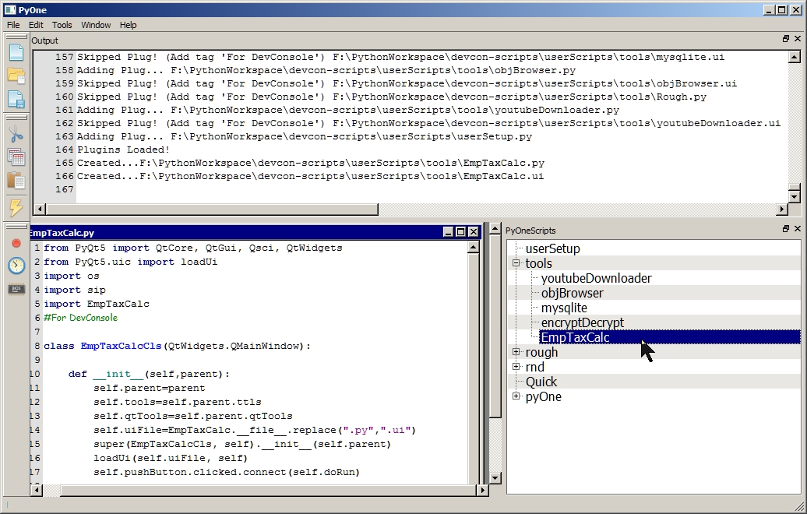

Step 6
Back in our PyOne Editor with EmpTaxCalc.py
Scroll down and look for a python method doRun as given below

Slide 19
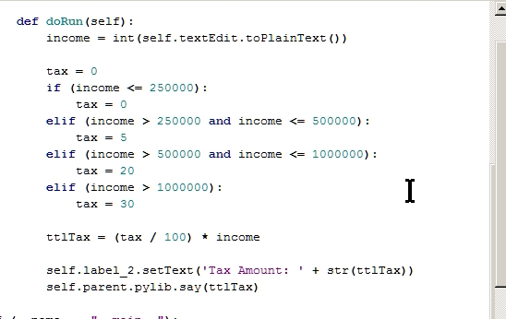
Step 7
Edit the doRun with below code and Save the script

Slide 20
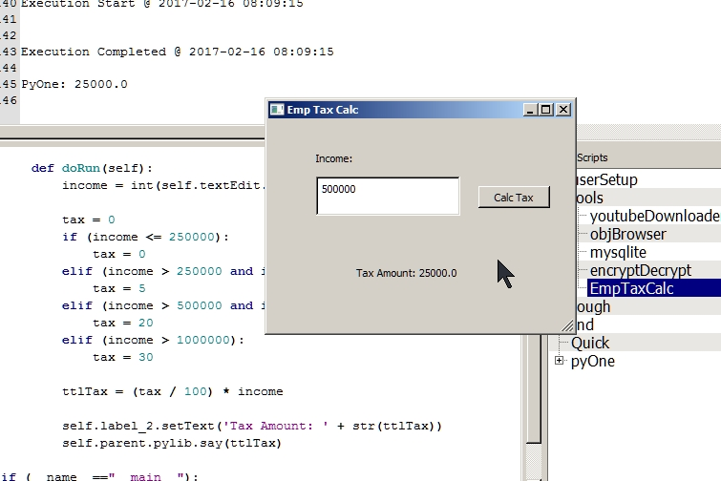
Step 8
Execute the code by double clicking the EmpTaxCalc in PyOneScripts
And
BINGO!
Your EmpTaxCalc tool is done!

Slide 21
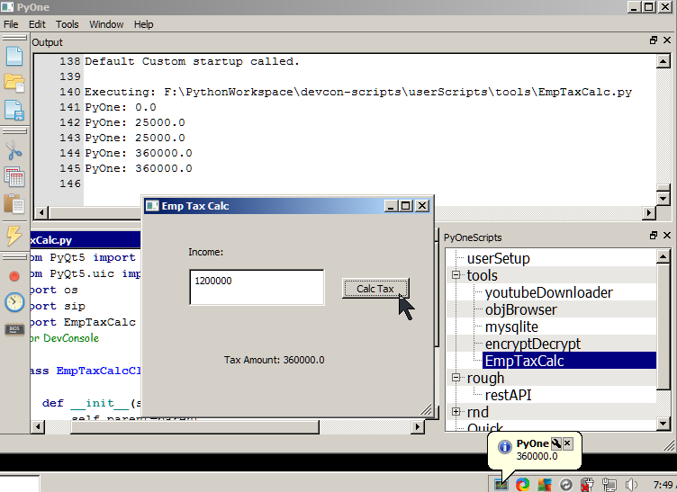
EmpTaxCalc

Slide 22
Think PyOne
On seeing above sample, You may ask…
“What’s the big deal? I can do the same in MS-EXCEL or MS-CALC”.
Consider I change the challenge as given below…
TAX Rule is dynamic and available in CSV somewhere in web-server.
Need to do the same calculation for 5 lakhs employees fetching the income detail from a DB and prepare another CSV with all TAX calculated.
Need to repeat the calculation in specific interval.
Update Cloud with details processed.
With additional lot more, Challenges!!!

Slide 23
Think PyOne

Slide 24
Disclaimer
PyOne features and functionalities are bound to the limitation of python, pyqt and windows. Most features and ability mentioned in this document are achieved with support of few third parties. It does exist few limitations to PyOne by its own which should be understood by users and can overcome with various third parties. PyOne author won't be responsible for any damages to hardware/ software or data loss caused by PyOne on mishandling them by the user. Please, discuss with author for gaining more knowledge about it. On critical usage.
PyOne Author

Slide 25
Note from author
I am Kumaresan Lakshmanan, author of PyOne Application. I am a mainstream developer (Java/Python/BPM/Integration etc) and I am not into any Devops. But still I hate doing redundant and manual works. Most time I used think of automation possibilities in my daily task like everyone does. But thought of having a customized unified portable solution. Thus I got my favorite programming language python to help me.
PyOne’s key points are Rapid, Dynamic, Flexible and Simple. I got this inspiration from python itself. Also I love coding in python. It's been 7 years now. I explored lot many technologies, but I never felt anything as easy and enjoyable like python coding. So this is just a small contribution to my favourite python to show its flexibility and features to this world.
This tools is not meant for any commercial use. This will remain open-source in public github and users are free to fork and contribute to source.
Kumaresan Lakshmanan
Year 2017
Chennai - India

Slide 26
Thank you Source Code https://github.com/kaymatrix/our-py-lib/tree/master/PyOneApplication
Contact kaymatrix@gmail.com
PyOne

